Slide 1
Pretesting
Wenchao Ma
University of Minnesota
Notes:
The aim when creating a survey is to produce the best possible items that measure the attributes of interest. Even if the items are on target, they must be presented in a format that is readily understandable so that people are motivated and are able to provide the best possible answers. To ensure that respondents interpret items as intended and the survey is presented properly, we pilot test the survey.

Slide 2
Pretesting
Pretesting is the process of evaluating the survey procedures in advance to assess
whether they are going to cause any problems for respondents and interviewers and
whether the survey is meeting its intended objectives (Presser et al., 2004)
Notes:
Once you have a complete draft of your survey, a pretest is a necessary next component of the research process. Pretesting your survey is an important way to pinpoint problem areas, reduce measurement error, reduce respondent burden, determine whether or not respondents are interpreting questions correctly, and ensure that the order of questions is not influencing the way a respondent answers. In other words, a pretest is a critical examination of your survey instrument that will help determine if your survey will function properly as a valid and reliable social science research tool

Slide 3
Pilot Testing
A preliminary, small-scale version, or "miniature version" of the entire planned research study. It is also referred to as a feasibility study.
It tests the complete research process—from data collection and logistics to tabulation and analysis—to identify and examine potential roadblocks before full implementation.
Determining if the full-scale study is possible (i.e., its feasibility), whether the procedures are sound, and whether the protocols can be followed.
Notes:
A Pilot Study is a small-scale dry run of the entire experiment or survey administration, whereas Pre-testing is specifically the "trying out" of the questionnaire/instrument itself.
Pre-testing is often considered a crucial element or a key phase that occurs within the broader Pilot Study.

Slide 4
Why Pretesting?
Gather others’ input to gain new perspective
Develop greater understanding of and empathy with desired respondents
Ensure questions are clear, comprehensible, and relevant to respondents (Collins, 2003)
Confirm that response options are sufficient and appropriate and that respondents can use them appropriately and consistently (Collins, 2003)
Notes:
Gather input and gain perspective.
It is easy for researchers writing their own surveys to become “too close” to the work and be unable to see problems that might be obvious to others. Pretesting questions, whether formally or informally, can provide the researcher with a new perspective, seeing the questions or entire survey tool through another’s eyes.
By asking potential respondents and/or informants who are familiar with potential respondents for their feedback, and by exploring their thinking when making sense of and responding to questions, researchers can gain a great deal of empathy for and understanding of respondents.
Pretesting questions is particularly helpful in ensuring that problematic questions, such as those that are leading or loaded, are avoided. Examining responses collected during pretesting can sometimes make potentially problematic questions immediately obvious, but researchers can also identify and troubleshoot such questions by asking respondents pretesting the survey to notify them directly when they notice such a question.
A simple but very effective use of pretesting is to confirm that response options are sufficient and appropriate for the specific respondents identified for the survey. Pretesting may identify a need for additional response options that weren’t originally anticipated or may uncover instances where there are too many response options, overlapping options, or options that are problematic in some other unanticipated way.

Slide 5
Why Pretesting?
Explore whether questions have particular forms of validity, such as face validity
Make initial assessment regarding the reliability of questions
Anticipate how the resulting data might best be analyzed
Test the mechanics of the survey in a real-world setting
Notes:
A survey question with validity is one that measures what it is intended to measure. A question with face validity is one that appears (to researchers, experts, colleagues, and/or respondents) to measure what it is intended to measure.
In some cases, pretesting can be used to explore reliability as well. Survey reliability refers to whether survey questions are answered consistently. That is to say, with a reliable survey, respondents answer similar questions in appropriately similar ways, or that results from survey administration efforts with similar populations are appropriately similar. Exploring reliability through pretesting is most likely to be accomplished through a pilot test in which enough data are collected to explore whether problematic patterns may be surfacing. There are three good indicators that survey questions may not produce reliable responses. Problems with reliability can surface when
a group of testers a researcher expects would answer the same way do not, in fact, answer in the same way;
testers provide different answers to similar questions; or
testers provide different answers to the same question asked at different times.
Gathering responses to draft survey questions through pretesting can also help researchers anticipate how to work with the data that will eventually be captured through a finalized survey. Sometimes the best way to set up a survey question for ease of response actually results in a more complicated analysis scenario. For example, “check all that apply” answer options are often the reasonable, or even ideal, choice, but this question type can present challenges for response analysis. Seeing how respondents answer these questions in a pilot effort, or learning how they think about their answers, may provide hints to the researcher about how best to analyze (or even eventually present) results.
More formal approaches to pretesting surveys, such as pilot testing, offer an opportunity to test the logistics and mechanics of the survey tool in an approximation of the expected survey conditions

Slide 6
Methods for Item Review in Pretest
Qualitative methods
Quantitative methods
Cognitive Interview
Behavior Coding
Expert review
Paradata
Respondent Debriefing
Focus Group Interview
Notes:
Although we have ordered item review methods by whether they are primarily quantitative in nature or qualitative, since qualitative data can be quantified and some quantitative data can yield textual information, the distinction between these two types of data is somewhat arbitrary.

Slide 7
Goal of item review
We assume respondents interpret items in the manner intended by the survey developer
identify if this is not the case
understand how respondents interpret items
Notes:
For all methods, our presumptive hypothesis is that the respondent interprets the item in the manner intended by the survey developer. We collect data to support or refute that broad hypothesis. Item review methods address problems in an item that cause the respondent not to interpret the item as intended.
The goal of reviewing items is twofold. First, item review is used to identify if there is a problem and pinpoint what the problem is. Some item review methods are better than others in performing this function. A second goal, probably less common though not uncommon, is to understand how respondents interpret items and hence why there is a problem.

Slide 8
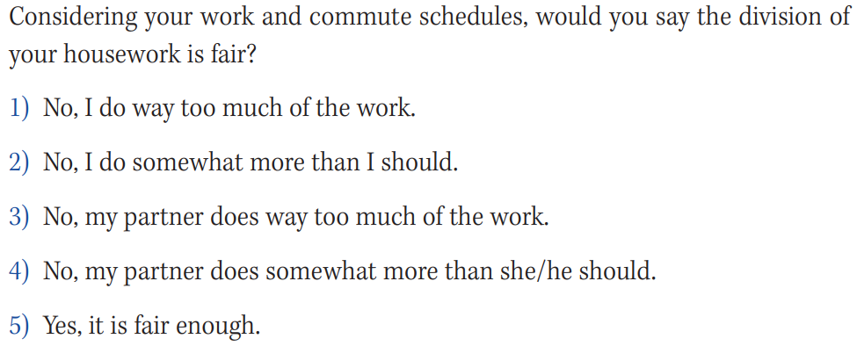
An example
Notes:
In this example, housework may be interpreted differently by men and women or by different individuals.
different respondents interpreted the phrase “half a day” to mean at least 4 hours, at least 5 hours, or at least 6 hours (p. 119);
different respondents interpreted “children” to mean those 5–10 years old, 5–15 years old, or 5–20 years old (p. 119);

Slide 9
Pretest sample size
Pretest the survey on at least 12 to 50 respondents from the target population

Slide 10
Cognitive Interview
The objective of cognitive interviewing is
to diagnose item ambiguities in language and response scale understanding, and
to identify challenges respondents experience and mental operations that may be inappropriate in responding to items.
CI Method Protocols
Think-aloud interviews
Verbal probing
Notes:
CIs are conducted one-on-one in a laboratory setting or on-line. They are labor-intensive and so are expensive if we need to hire interviewers and pay interviewees. Data generated by CIs are often not formally analyzed, but results can be quantified by counting the number of problems encountered with a question.

Slide 11
Cognitive Interview
Conduct one-on-one in a laboratory setting or on-line
Ask respondents to verbalize whatever comes to their mind as they respond to each of the items presented to them
Interview needs to be audio or video recorded
Data generated by think-aloud are often not formally analyzed, but results can be quantified by counting the number of problems encountered with a question.
Notes:
During the interview, interviewers instruct and encourage participants to simply “talk,” and once the participants start to talk, the interviewers let the participants respond to all items in the survey without interruption or probing from the interviewers.

Slide 12
Think-aloud interviews
A sample instruction
Thinking aloud may be new and unfamiliar to you, but please know there are no wrong answers. I am only interested in knowing what is going through your mind. Before we begin the actual interview, I’d like to ask you a ‘warm-up’ question to introduce you to the think aloud process. Feel free to comment or ask questions as you read and answer the question. I did not write the questions and you will not hurt my feelings, no matter what you say. There are no wrong answers. What questions do you have before we get started?

Slide 13
Verbal Probing Interview
Concurrent verbal probing
Retrospective verbal probing
Notes:
Verbal probing can be done concurrently or retrospectively. Concurrent verbal probing involves presenting the participants the cognitive probing questions immediately after each item or a series of items (e.g., background questions or scale items). Retrospective verbal probing requires each participant to complete the whole survey (respond to all the survey questions) first and then go back through the survey questions again to respond to questions in the probing protocol. Willis (2004) pointed out that concurrent probing is more frequently used than retrospective probing. The latter is chosen only when (1) the purpose of testing is mainly to determine the subject’s ability to manage a self-completion instrument unaided and/or (2) the researcher wants to simulate a field procedure.

Slide 14
An example of concurrent verbal probing
Interviewer (asks targeted survey question) In the past 7 days, on how many days did you walk for exercise.
Subject Uh, three.
Interviewer (probe) Tell me about those times.
Subject Well, I probably went to the gym twice, and I also walked to the store yesterday. I’m assuming you want to include that – it’s uphill and I did get some real exercise carrying those bags.
Interviewer (probe) How sure are you that these were all in the past 7 days?
Subject I don’t know – I usually go to the gym twice a week. I don’t remember anything diﬀerent about this last week, you know, in that regard.
Notes:
On the basis of probing, several details emerge beyond simplythe initial answer of “three”: (i) The subject assumes that walking to a shopis intended to count (which may not necessarily ﬁt the researcher’s intent);and (ii) he/she is making a judgment based on usual behavior, as opposed torecalling enumerated episodes.

Slide 15
An example of retrospective verbal probing
Interviewer: Earlier I asked you the question: In the past 7 days, on how many days did you walk for exercise? Do you remember how you answered that?
Subject Uh, yeah, I think I said three times.
…
Notes:
From this point on, probing (and presumably, subject responses) couldunfold just as for the example involving concurrent probing. Note thefundamental diﬀerence introduced by the debrieﬁng approach: (i) Theinterviewer must re-read (or otherwise present) each question to be probed; and (ii) as the response is no longer in the subject’s short-term memory, theinterviewer must then either ask again for the previous answer, or else remindthe subject of it. P

Slide 16
Verbal Probing Interview – sample probing questions
Asking respondents how they arrive at their answers.
“Why did you choose [‘infrequently’]?”
“How did you come up with the number [4]?”
“What process did you go through to decide on [‘often’]?”
“What went through your head when you choose [‘somewhat agree’]?”
“Why did you select the response you did?”

Slide 17
Verbal Probing Interview – sample probing questions
Asking respondents to paraphrase their understanding of the question or part of the question.
“In your own words, what is the question asking?”
“What does the term...mean to you in this question?”
“What does ‘moderate to intense’ mean to you?”
“Can you repeat the question in your own words?” “What terms need to be defined?”
“What terms need examples to help explain them?”

Slide 18
Verbal Probing Interview – sample probing questions
Asking respondents how confident they are that they can give an accurate answer.
“How sure are you of your answer?”
“Are you sure about your answer?”

Slide 19
Verbal Probing Interview – sample probing questions
Asking respondents for any uncertainties or confusion they had about what the appropriate answer was.
“Is there any specific part of this item (including the statement and options) that you are not comfortable with?”
“Is there anything in this item that confuses you?”
“Is there anything that didn’t feel right or missing?”
“Was there anything that seemed redundant or should be deleted?”

Slide 20
Verbal Probing Interview – sample probing questions
Asking respondents for suggestions for improving items.
“How would you improve the item?”
”What can be done to this item to make it better?”
“What needs to be expanded?

Slide 21
Think-Aloud vs Verbal Probing
Think-Aloud
Verbal Probing
(+)Fewer interruption
(+)Minimal interviewer training
(-)depends on respondents
(+)Less dependent on respondents
(-)Potential bias
(-)Respondents may not remember in retrospective verbal probing
Notes:
Pros of the think-aloud method include freedom from bias imposed by frequent interviewer interruption and minimal interviewer training. Cons include a need for some interviewee training in the method, interviewees may not be comfortable or facile in reporting their thinking processes, and interviewees may bias descriptions of their mental processing. If respondents are well-trained to think aloud, the think-aloud interview provides a good window into how questions are understood and answers generated. However, as respondents vary in how well they can think aloud, some might have difficulty verbalizing their cognitive process while people with more formal education might have less difficulty.
Unlike the think-aloud procedure, verbal probing simulates the manner in which questionnaires administered face-to-face are typically completed (in which the researcher simply asks questions and the interviewee answers them), and it requires minimal or no training and practice by the participants. In addition, interviewers have better control of the interview, albeit potential bias could be introduced through selection of probes. Retrospective probing may be simpler but respondents may not remember what they were thinking when they answered an item.

Slide 22
Cognitive Interview – Data Analysis
Data from cognitive interview are text
We use data to understand
which items and which words in items are confusing to interviewees,
which items or words in items are misinterpreted by interviewees, and
how to revise the items so they are clearer.
Notes:
Results of CIs provide detailed depictions of the processes and difficulties respondents encounter in understanding and responding to items. For example, through verbal probing, respondents state in their own words what the question means to them and state in their own words how they construct a response or choose one response option instead of another. The primary goal of CI is to gain an understanding of whether respondents consistently understand the questions in the manner intended by the researcher, whether the question elicits an accurate response—do respondents possess the information needed to answer and are willing to do so—and so are the responses provided likely to be valid.

Slide 23
Expert Review
Select three to six experts—qualifying as an expert requires familiarity with the topic of the survey and/or survey methodology.
Experts conduct their reviews independently but could review items as a group.
A rating form is often used to record reviews and reviewers are often asked to read items for bias and for technical flaws
Notes:
Expert review is also used to assess surveys, typically with a small number (3–6) of experts being asked to identify item flaws in content, wording, or response options. Reviews may be less or more structured; Expert review can be conducted with varying levels of organization and rigor. On the low (and quick) end of the spectrum, a read-through of a draft questionnaire by an experienced subject matter export or survey methodologist can identify issues with question wording or administration that may lead to measurement error. On the more formal and rigorous end of the spectrum are methods such as RTI's Question Appraisal System (QAS).

Slide 24
Checklist for Quality Question Design (Robinson & Leonard, 2018)
assist the survey researcher in designing an effective survey instrument that will elicit a rich, robust, and useful dataset
This tool will be of greatest use if the following has already been determined:
That a survey is indeed the appropriate tool to meet data collection needs
The research or evaluation questions and information
The population or sample of desired respondents
How the survey will be administered: online, paper, by phone, in person, or some combination of these
Going through the checklist for each survey question

Slide 25
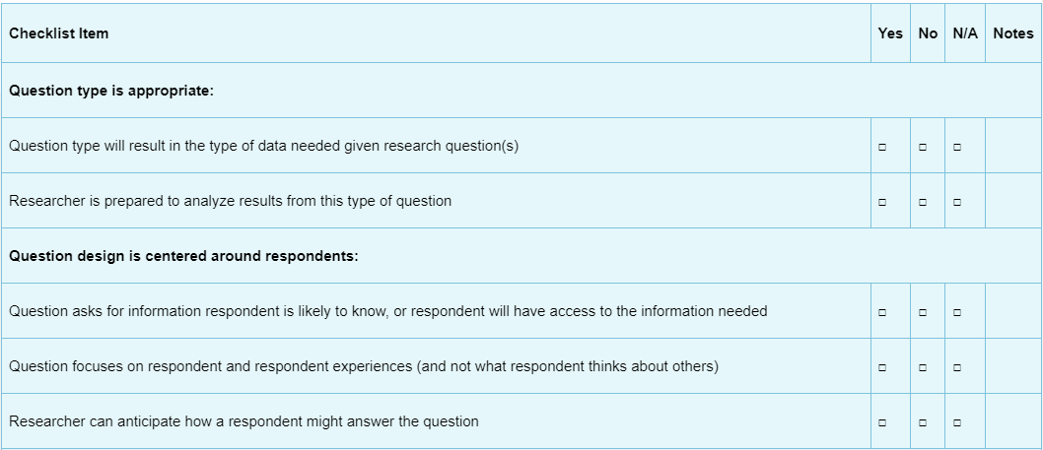
Checklist for Quality Question Design (Robinson & Leonard, 2018)

Slide 26
Question Appraisal System
Question Appraisal System QAS-99

Slide 27
Expert Review
Use those checklist as a starting point
All surveys are different – apply the checklist in light of the survey context

Slide 28
Respondent Debriefing
Respondent debriefing involves informal or specific, structured, and standardized follow-up questions
Goal is understanding how respondents interpreted the survey items after the respondent completes the survey
Can be conducted individually, or use a standardized form administered on-line
Notes:
Respondent debriefing involves informal or specific, structured, and standardized follow-up questions with the purpose of understanding how respondents interpreted the survey items after the respondent completes the survey. The debriefing questions are usually asked by an interviewer, although the debriefing can also be self-administered either on paper or on-line.
CI is more typically used at an earlier stage of the survey development process while debriefing follows development of a semi-final survey version. Debriefing questions can yield information about misunderstood words or phrases which helps the survey designer to rephrase questions, add instructions, etc.
We can conduct respondent debriefing individually, or we might opt to use a standardized form administered on-line, for instance, to an entire group of participants, or some subset of participants who have already completed the survey.
Those who responded to the survey were asked about their initial impressions of the envelope, whether any questions were difficult or sensitive, who completed the form, and whether they had a favorable or unfavorable impression of the form. Nonrespondents were asked whether the envelope was ever opened, whether the survey was ever started, whether any questions were difficult or sensitive, and why the household chose not to respond.

Slide 29
Focus Group Interview
Sometimes used to generate content/ideas for item writing
Can also be used to evaluate a set of potential items

Slide 30
Focus Group Interview
Prior to the focus group, participants are usually recruited
The ideal size for a focus group is generally between six and twelve people.
Notes:
Too-small groups are easily dominated by one or two members. Too large a group lacks cohesion and may break up into side conversations, or people may become frustrated if they have to wait their turn to respond or to get involved.
Care needs to be taken to ensure that people who know each other are not recruited into the sam e sessions. People are generally more open and less guarded with people they don’t know and don’t have to worry about ever seeing again. Absolutely never put people together who are in som e chain of command (e.g., supervisors with employees, teachers with students, etc.).

Slide 31
Focus Group Interview - Procedure
At the focus group itself, the moderator begins with an introduction that should include the following:
explaining the purposes of the focus group
laying down some basic ground rules to encourage everyone to participate in the discussion
reassuring the participants about the voluntary and confidential nature of their participation
introducing the moderator and any co-moderators and explaining how and why these group members were invited to participate
stating the purpose of note taking and recording.

Slide 32
Focus Group Interview – sample questions
Understanding the Questions
How do you interpret this question: “[Insert survey question]”?
Is there any part of this question that is unclear or confusing?
What do you think the question is trying to measure?

Slide 33
Focus Group Interview – sample questions
Relevance and Context
How relevant do you think this question is to your experience?
Can you think of any situations where this question would not apply?
What additional context or background information would help you understand this question better?

Slide 34
Focus Group Interview – sample questions
Completeness of the Questions
Do you feel that this question covers all the necessary aspects of the topic?
Are there any important aspects that you think are missing from this question?
If you could add a follow-up question to this, what would it be?

Slide 35
Focus Group Interview – sample questions
Response Options
Are the answer choices provided adequate for this question? If not, what would you suggest?
How would you feel about the format of the response options? (e.g., Likert scale, multiple choice, open-ended)
Is there any response option that you find confusing or misleading?

Slide 36
Focus Group Interview – sample questions
Tone and Sensitivity
How does this question make you feel? Does it seem respectful and appropriate?
Are there any words or phrases that you think may be off-putting or insensitive?
How would you suggest adjusting the tone to be more inclusive or relatable?

Slide 37
Behavior Coding
BC was initially implemented to monitor interviewer performance, by
identify instances where the interviewer has diﬃculty asking questions,
the respondent has diﬃculty answering them, or both
BC in its normal form is only applicable to interviewer-administered instruments
BC is usually applied at a later point in the development of a survey questionnaire than is cognitive interviewing
BC is often conducted as part of a pilot test (i.e., a dry run)

Slide 38
Behavior Coding - procedures
Development of coding scheme
Development of system for recording and processing results.
Collection of audio data.
Compilation of codes, for each item.
A summary table can be produced which displays frequencies of each coded item, over all interviews
A criterion can be set for problem frequencies to identify particularly problematic items—typically around 15% as suggested by Fowler (2011)

Slide 39
Behavior Coding
Common “interviewer codes” include
interviewer reads question exactly as worded,
makes minor changes, or
makes major changes.
Common “respondent codes” are
respondent asks for clarification,
respondent gives an inadequate answer,
respondent asks interviewer to repeat the question,
respondent interrupts,
respondent provides a qualified answer (indicating uncertainty), or
respondent provides an adequate answer.

Slide 40
Paradata
A variety of possible measures of auxiliary data regarding survey response behavior such as
response time
eye movement
logfile data
Response latencies that are systematically longer could be used as a flag for item review
Notes:
These data are either by-products of computerized on-line survey administration systems (audit trails, use of function keys such as F1 to access a help screen in an on-line survey administration, and interviewer observations and notes), or are collected as part of the operational running of surveys (time taken to complete a survey on-line, number of callbacks to schedule a phone interview, eye movement tracking, mode of communication, whether the respondent was reluctant to answer questions, and administration process)
On-line survey platforms (e.g., Qualtrics and SurveyMonkey) can automatically record and output response latencies if set up to do so.

